Slide 1

“THE SAFE TAXI”
Presented By: Adrian, Bilal, Emmily, Evan, Hamza, Joaquin,
Kartike, Luxsika & Tejveer

Slide 2
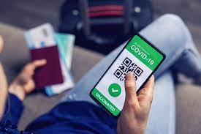
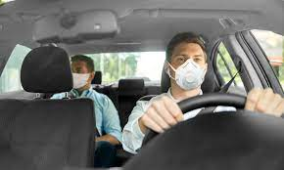
Introduction
Serves the objective of reducing carbon emissions and traffic by reducing the number of cars on the road
Uber companies provide approximately 4 million rides a day to customers
Ride-hailing vehicles have not been developed to deal with the Covid-19 pandemic nor have strict protocols in place
Public Health Ontario discovered that public transportation in Toronto plummeted by 71% at the beginning of the pandemic
This unhygienic system needs to change in order for us to be able to recover from this pandemic

Slide 3
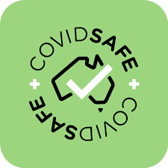
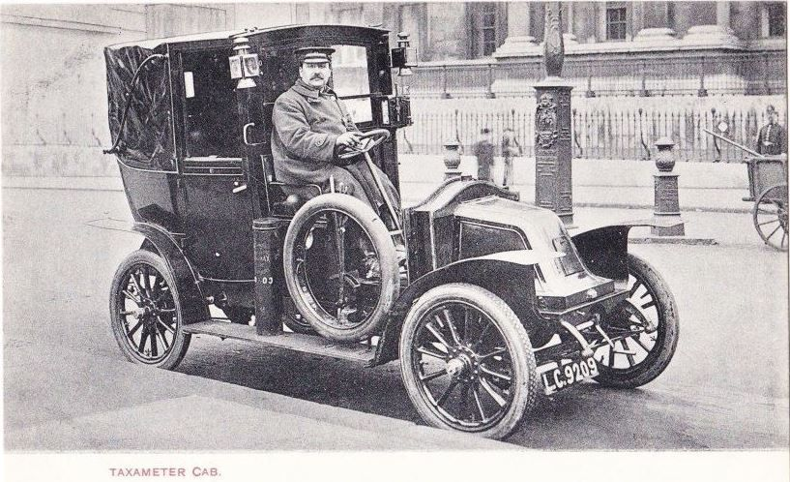
Background
The goal of our team is to reverse engineer the cars used in the Taxi/Uber industry and make them Covid-19 safe
The function of this product is to provide a safe and comfortable space for all passengers while riding the Safe Taxi
Combustion powered taxis equipped with taximeters first made its appearance in 1907
Uber’s revenue for the first quarter of 2020 was 3.25 billion dollars and in the second quarter was 1.91 billion dollars

Slide 4
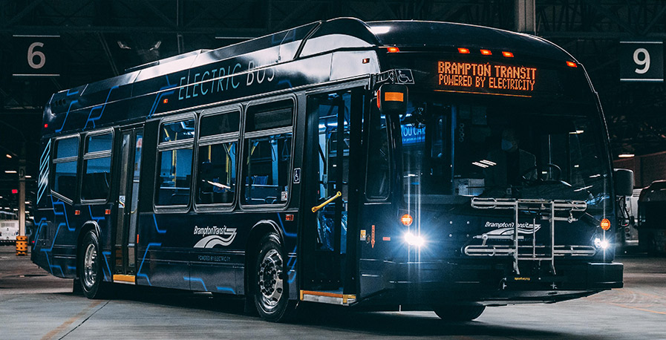

Current-uses
Means of transportation
Concepts can be applied in other products
Plexiglass, Ventilation, Contactless pay
Trains, Buses, Planes

Slide 5
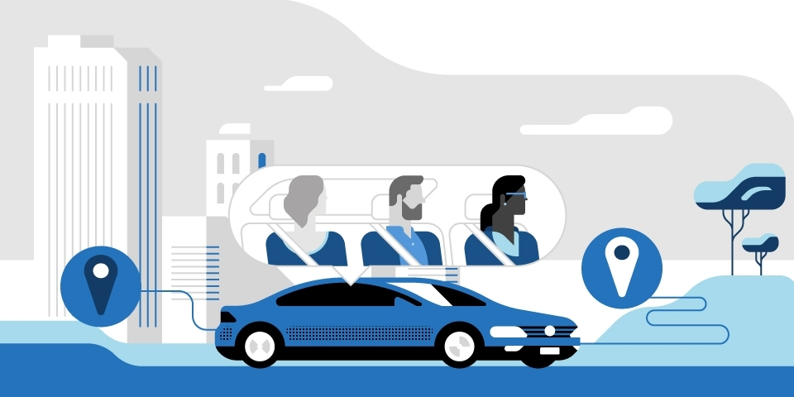
Limitations
More modifications are required.
Upgraded ventilation systems.
More dividers.
Less passengers can be carried at a time.
Uber Pool

Slide 6
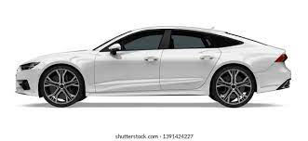
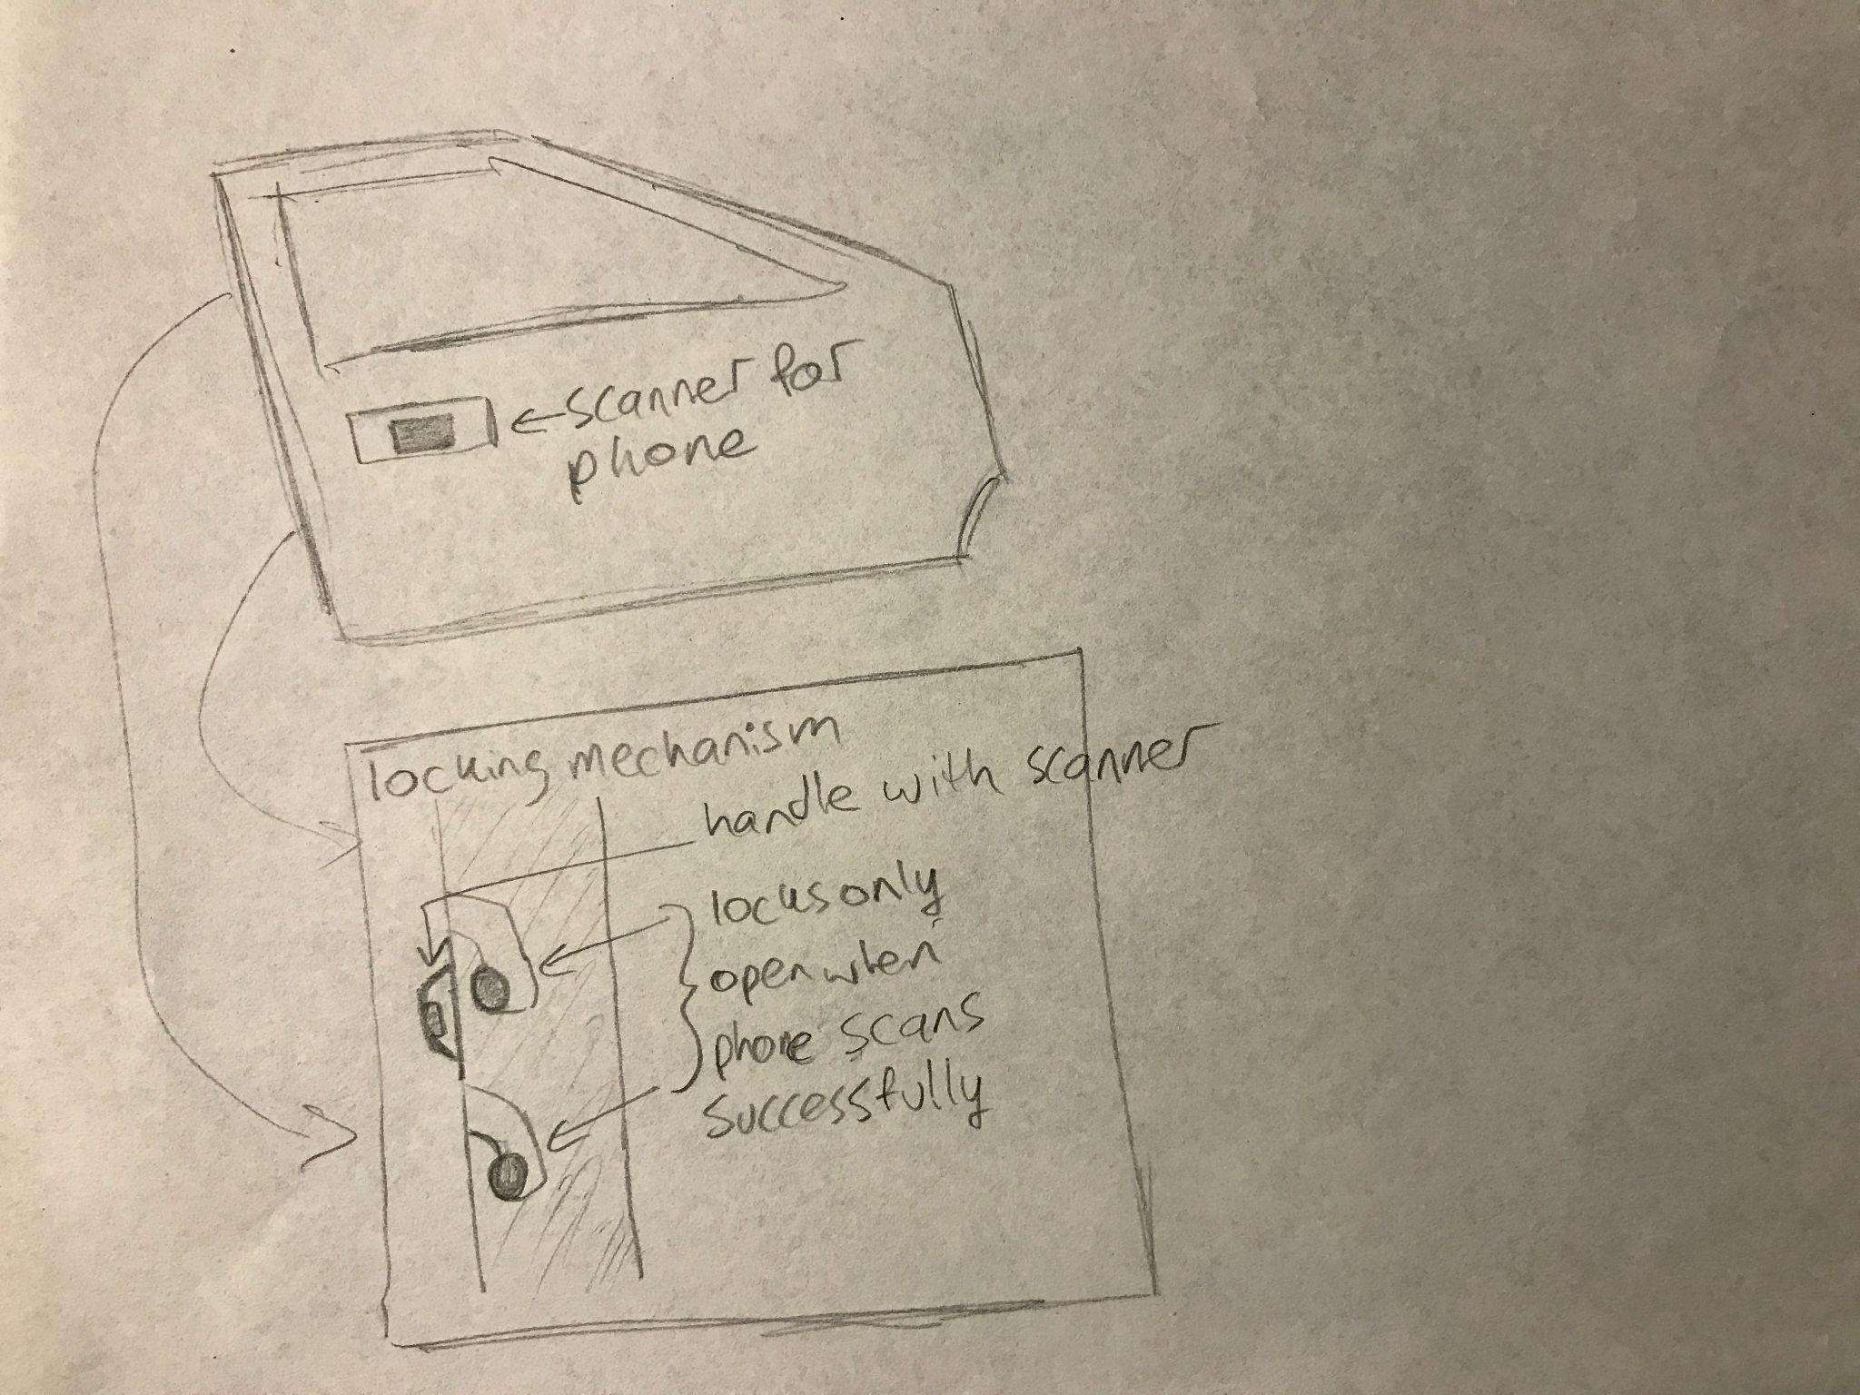
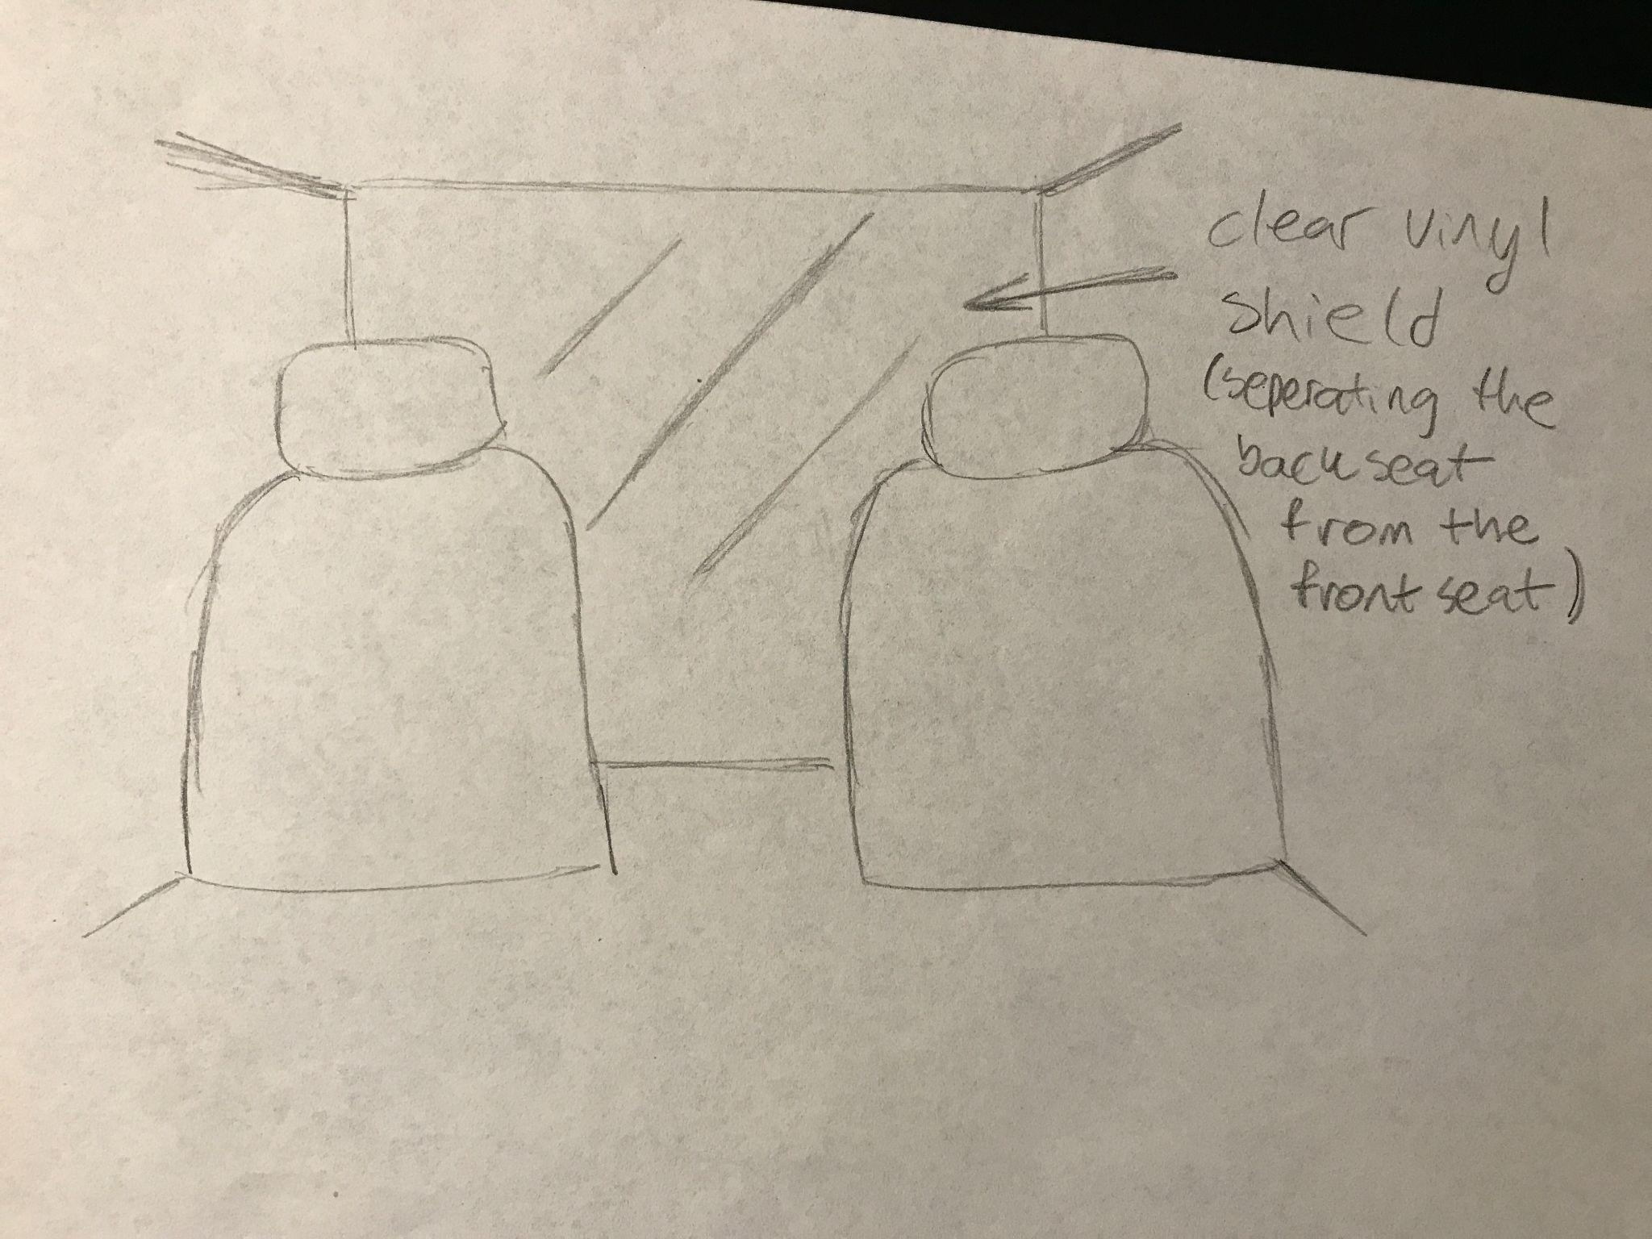
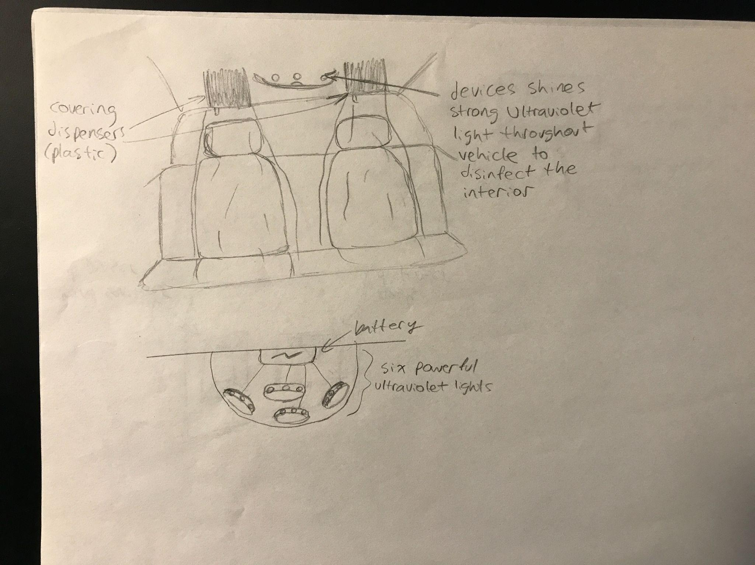
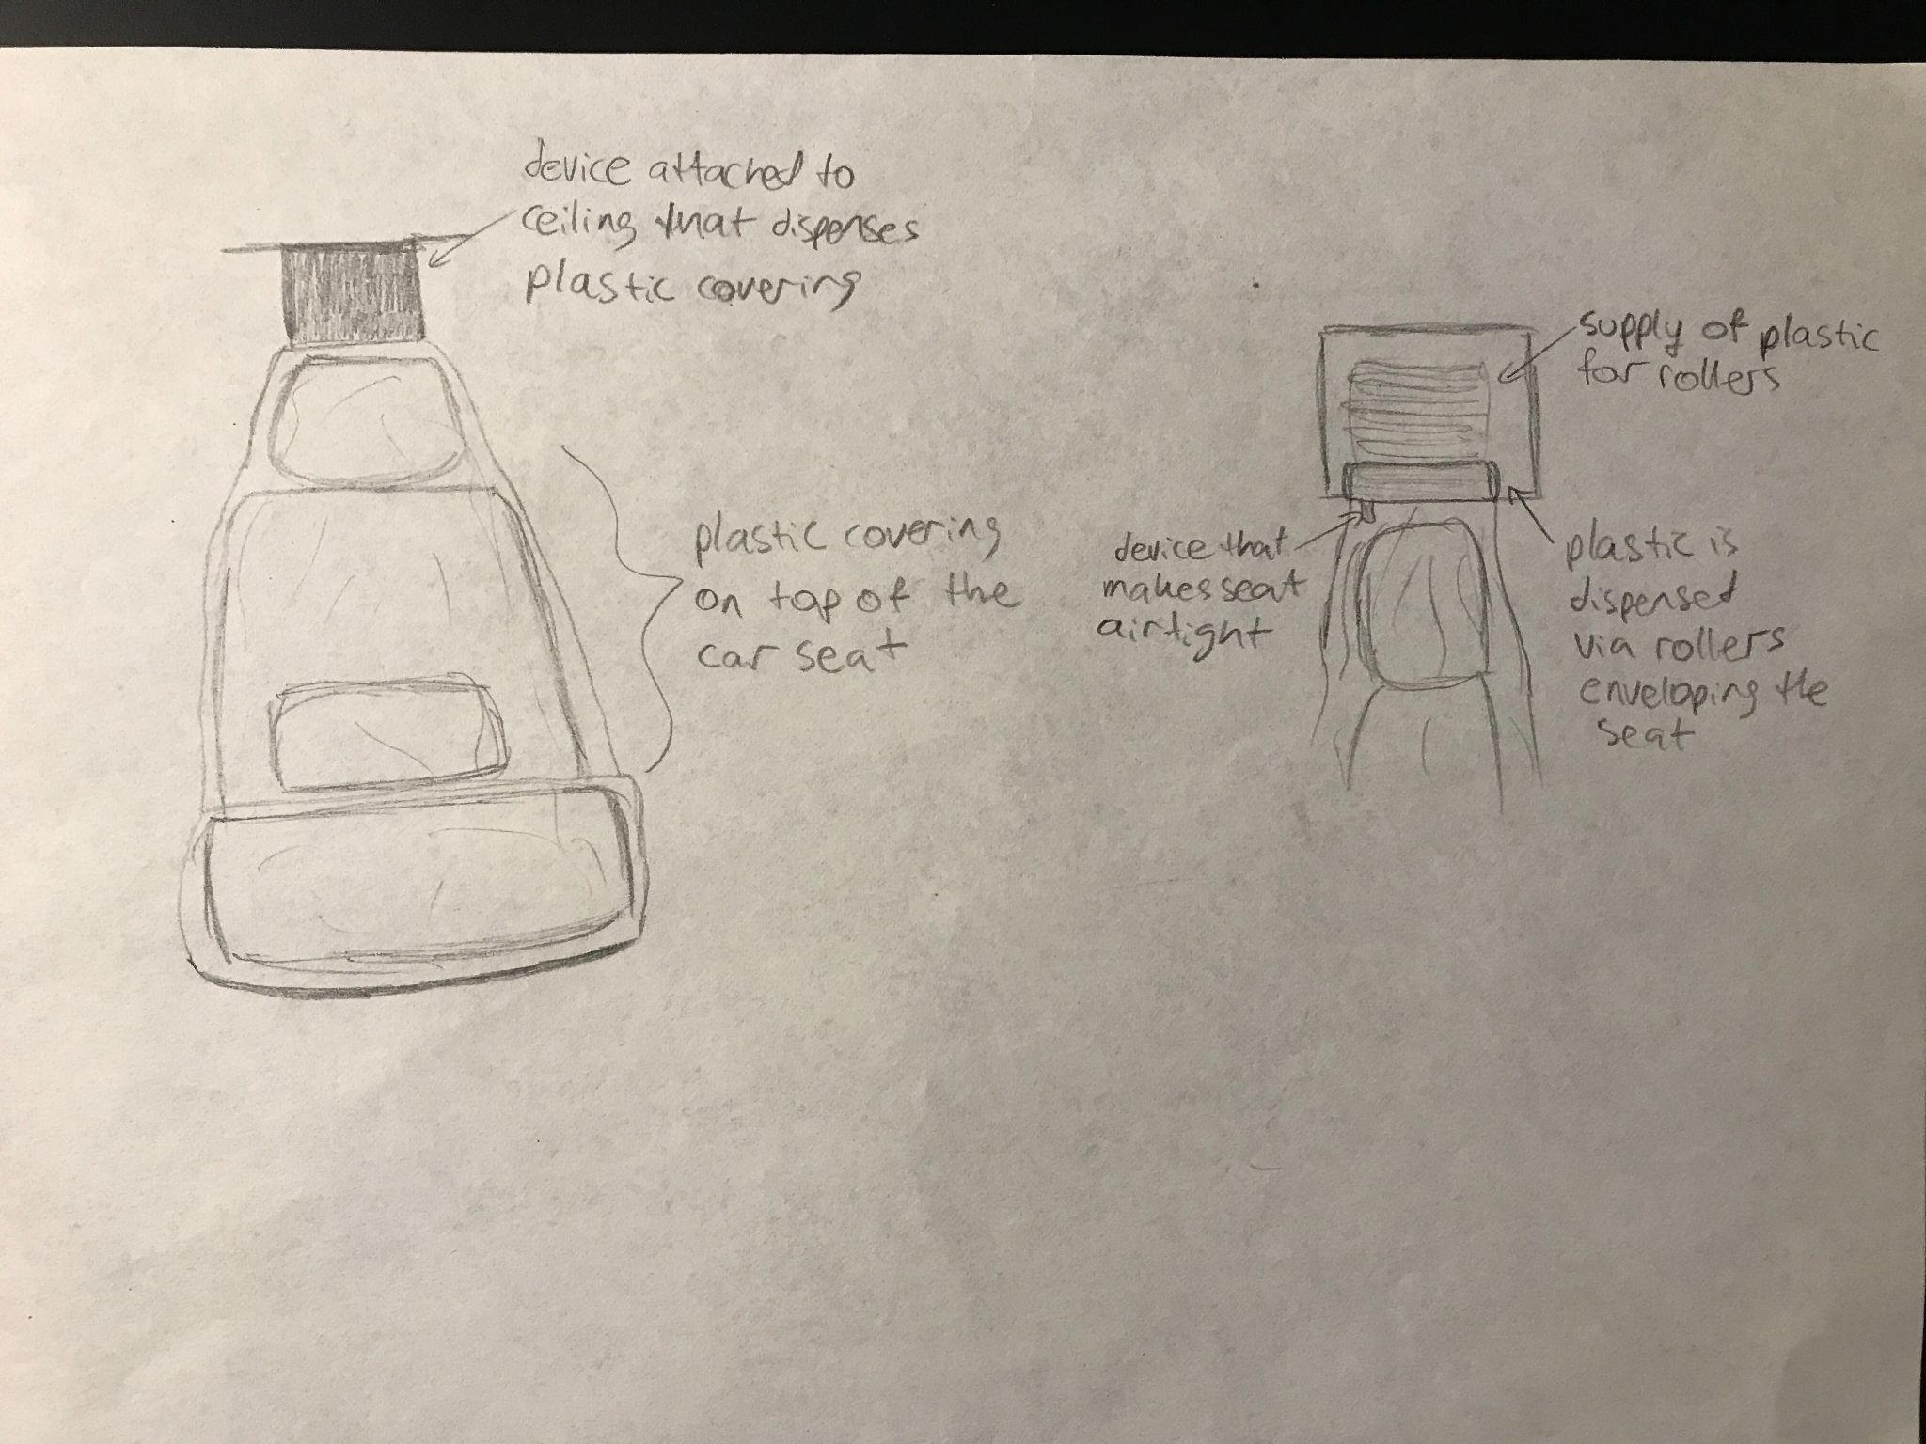
1st Iteration
CONTACTLESS PAYMENT AND CONTACTLESS DOOR
PASSENGER DRIVER SHIELDS
UVC RADIATION LAMPS
REPLACEABLE SEAT COVERS

Slide 7
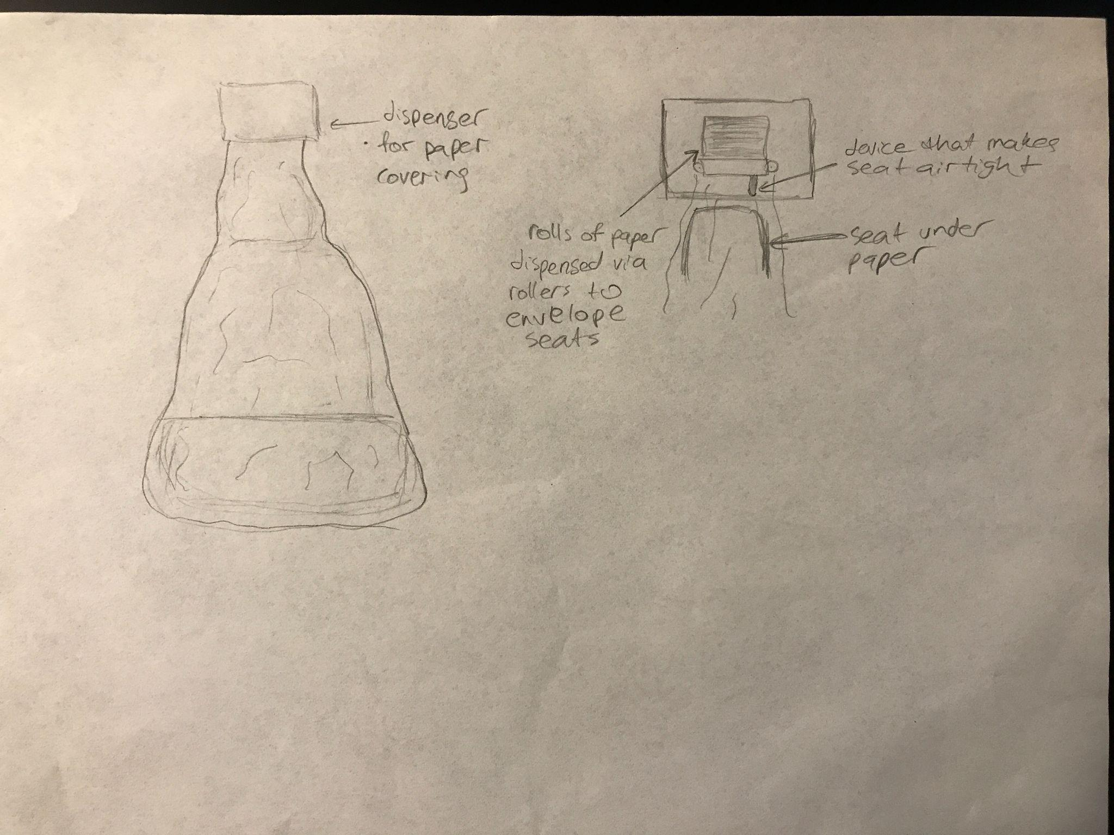
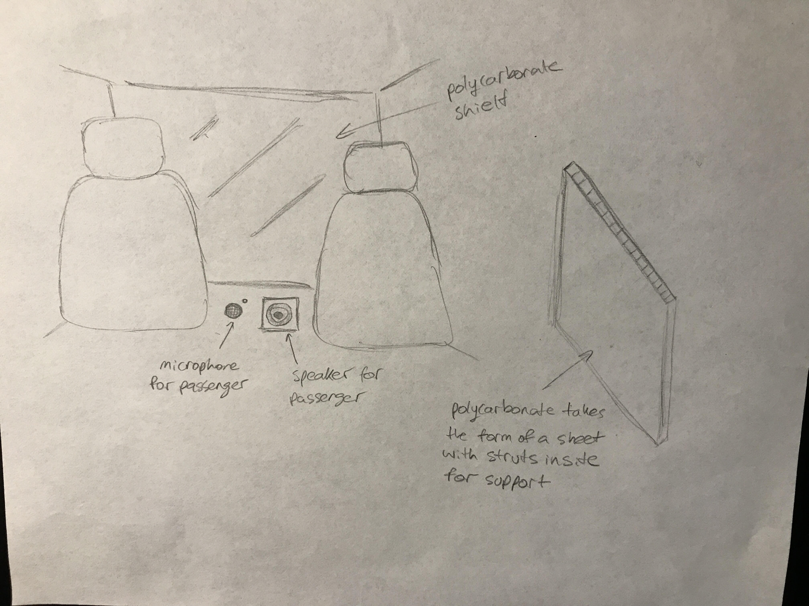
2nd Iteration
Contactless door, pay and UVC lights remain the same
New Seat Coverings
Replaced plastic with thin, recyclable paper
New Passenger-Driver Shield
Replaced clear vinyl with polycarbonate
Microphone & Speaker System
Allows for better communication
Paper seat covers
Microphone and polycarbonate shield

Slide 8
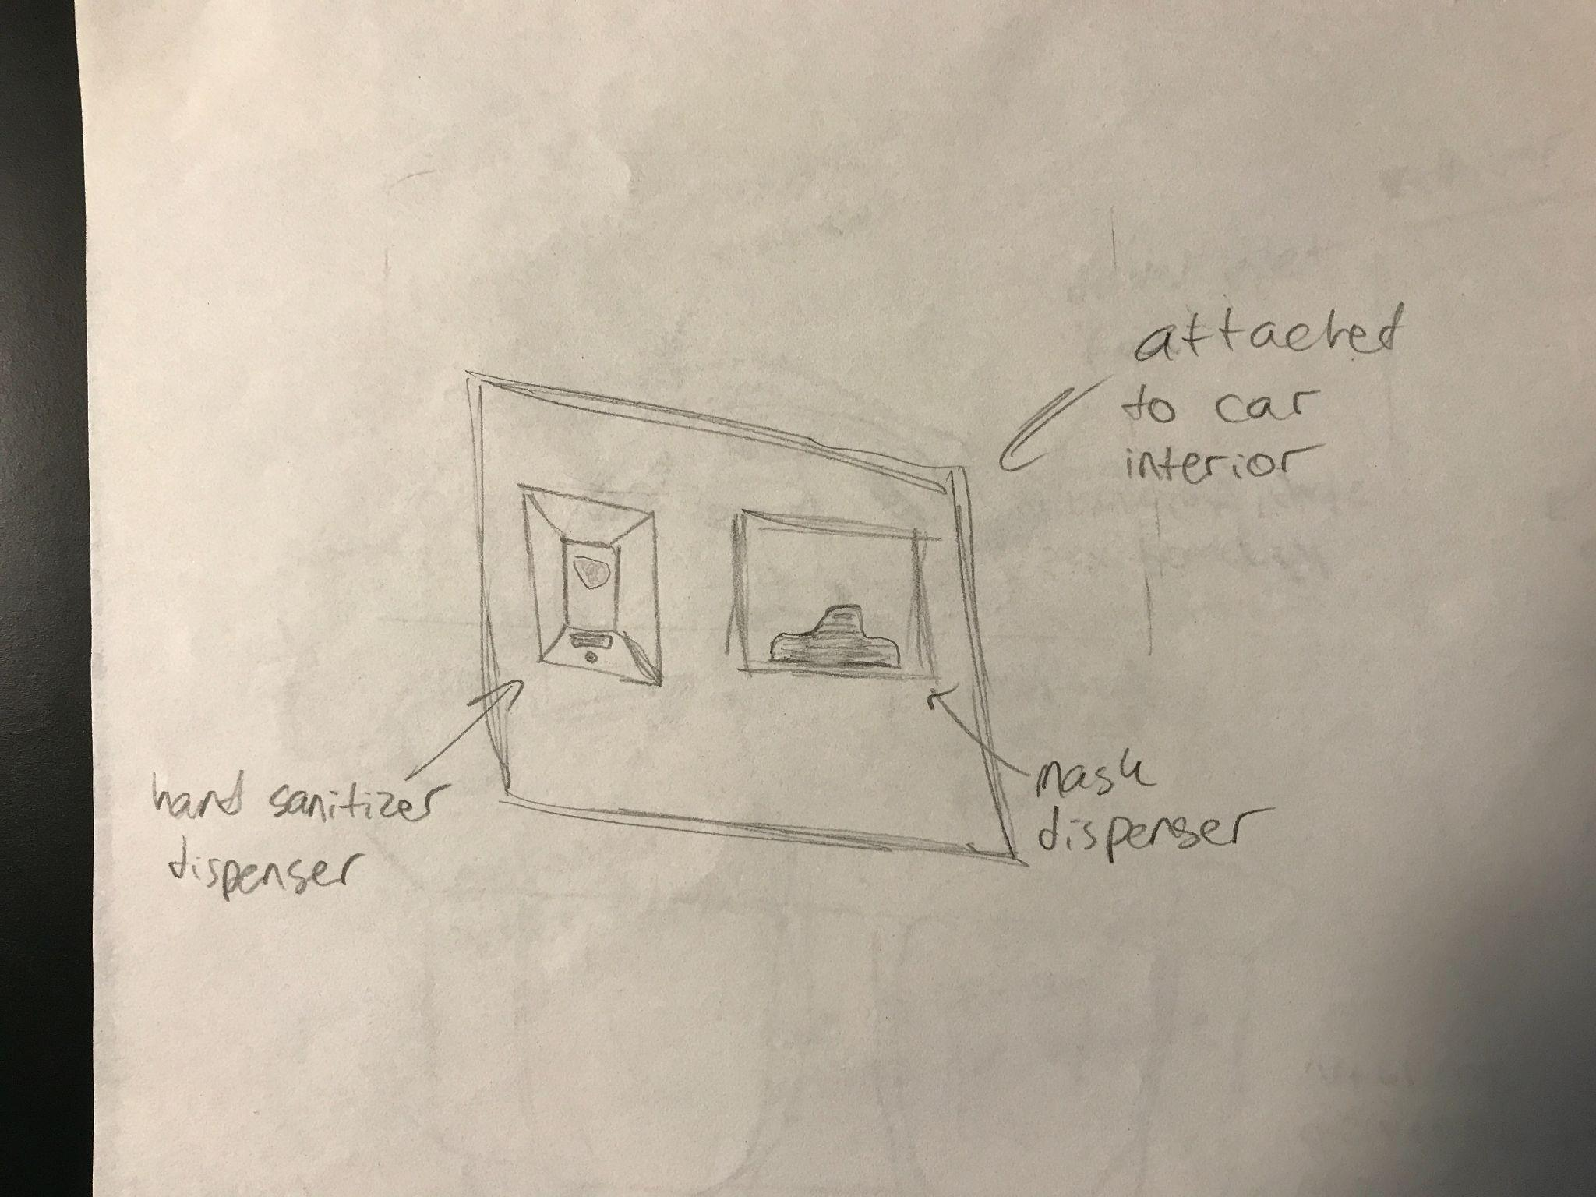
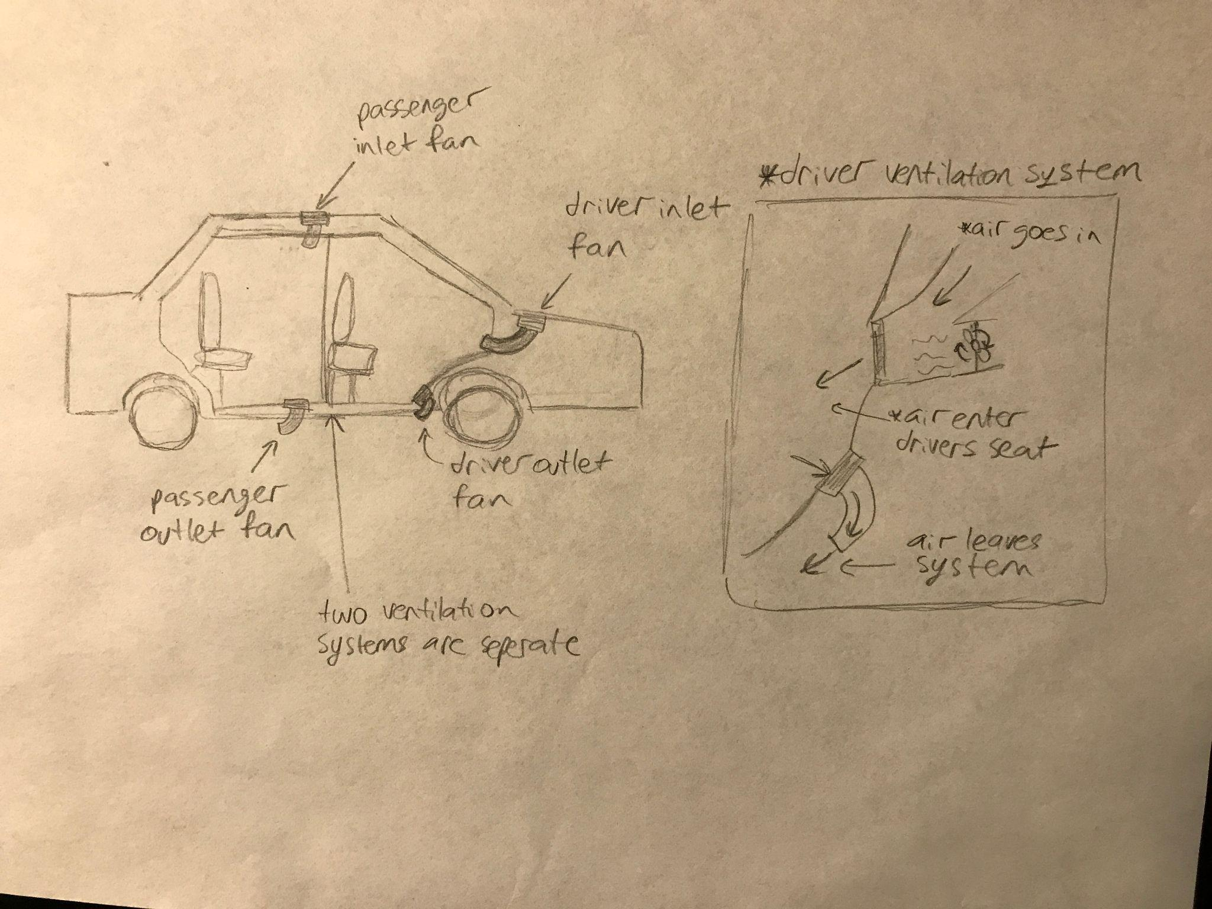
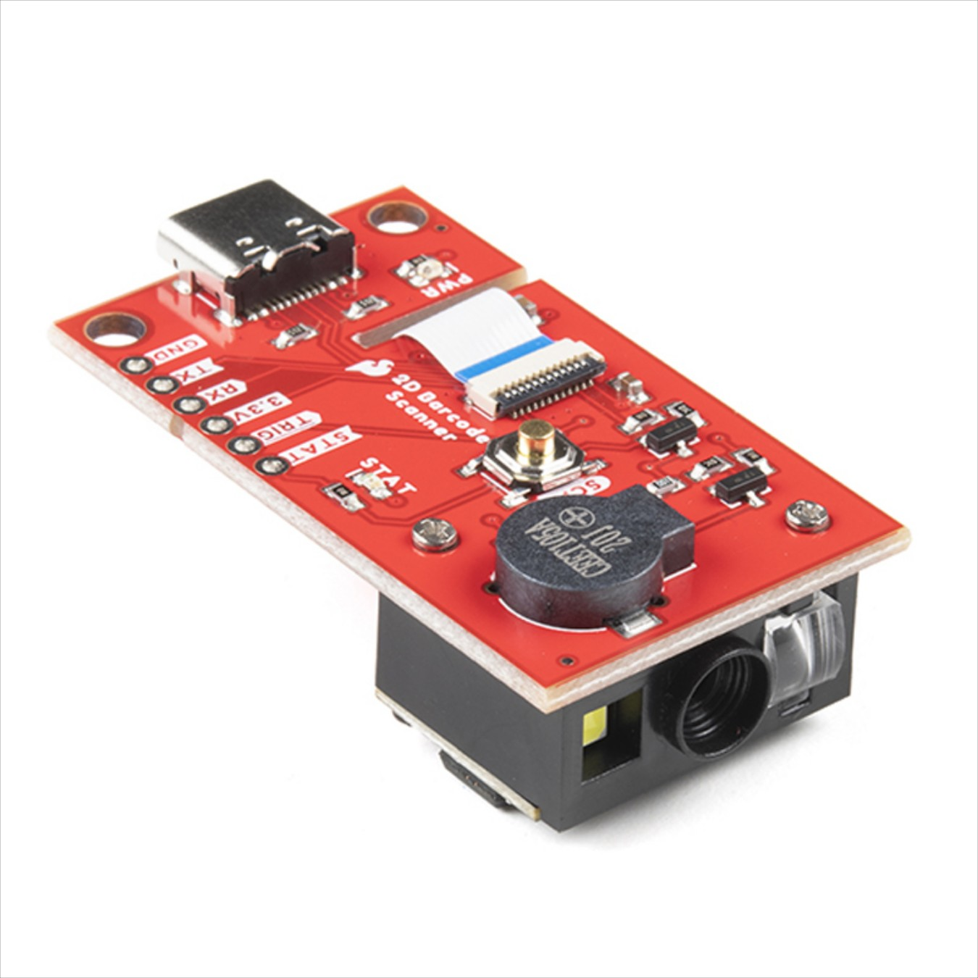
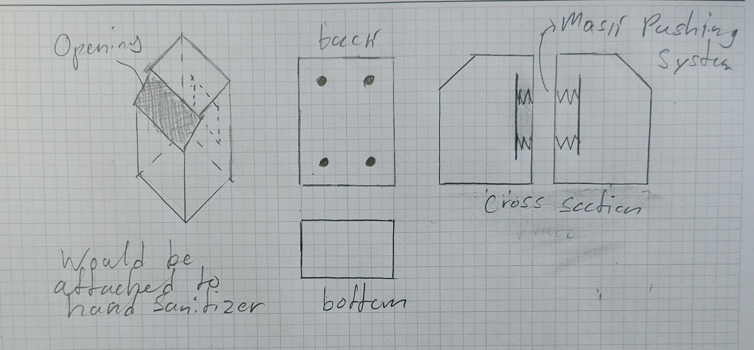
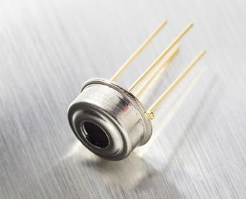
3rd Iteration
Covid Safety Item Dispenser
Dual Ventilation System
Components for Amalgamation Device

Slide 9
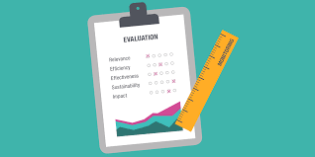
Evaluation
The team at Safe Taxi used eight qualities to evaluate the Safe Taxi:
Durability
Sustainability
User Experience
Accessibility
Profitability
Affordability
Performance
Public Good

Slide 10
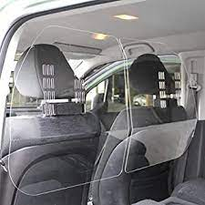
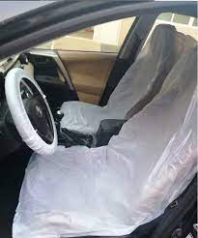
Durability
Original
Fairly Durable designed with safety features
1st Iteration
Durability of vehicle remained the same
Although clear vinyl shield and seat coverings were flimsy and not durable
2nd Iteration
Replaced old shield with new polycarbonate shield, increasing durability
Replaced plastic seat covers with paper seat covers making seats recyclable
3rd Iteration
Nothing substantial was added to effect Durability

Slide 11
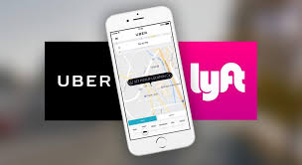
Sustainability
Original
Taxis typically last around 3 years
Taxis are often recycled
1st Iteration
Clear vinyl shields and plastic coverings needed to be replaced often
This is an issue as plastic is not easily recycled
2nd Iteration
New polycarbonate shield does not need to be replaced as often
New paper seat covers are easily recycled
3rd Iteration
Nothing substantial was added to affect Sustainability

Slide 12
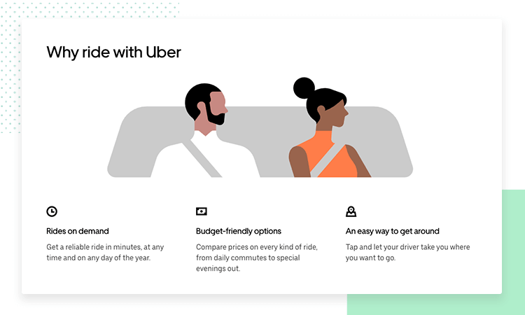
User Experience
Original
User experience does not involve any protection from Covid-19
1st Iteration
Safety features such as contactless pay and door, replaceable seats, and the passenger shield serve the purpose of making the passenger more comfortable
2nd Iteration
Added a microphone to make the communication between the passenger and the driver more simple
3rd Iteration
Uses HEPA filters and a dual ventilation system to make the user even more comfortable, knowing that they are more safe

Slide 13
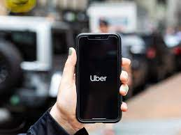
Accessibility
Original
Regular Taxis have not changed to become more accessible in the pandemic
New design (common across all iterations)
All Safe Taxis serve the purpose of making taxis more accessible to all people in a pandemic
As long as people have access to a mobile device they are able to use the safe taxi

Slide 14
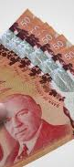
Affordability
Original
As of the modern day taxis are estimated to cost around $19450
1st Iteration
Cost of iteration 1 totals to about $19920
2nd Iteration
Cost of iteration 2 totals to about $19910
3rd Iteration
Cost of iteration 3 totals to about $19970

Slide 15
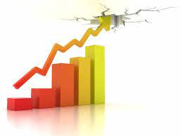
Profitability
Original
Taxis will ultimately cost less than a Safe Taxi and will therefore cause the expenses to increase
New design (common across all iterations)
It may require the taxi company to have to increase the fair of taxis, in order to profit from the Safe Taxi

Slide 16
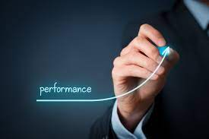
Performance
Original
Taxis do not protect people from the pandemic
1st Iteration
New features such as contactless pay and contactless doors, disposable seat covers, a clear vinyl shield, and UV light disinfector increase the safety from the pandemic
2nd Iteration
Makes plastic shield more durable, and thus more well suited against the pandemic
3rd Iteration
Uses HEPA filters and a dual ventilation system to make the passenger and driver even more safe

Slide 17
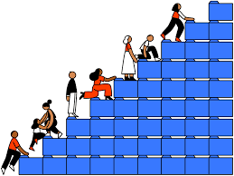
Public Good
Original
Taxis are essential in today’s society, but they have not done anything to adapt to the pandemic
New design (common across all iterations)
All iterations serve the same public good of protecting people from the current ongoing pandemic

Slide 18
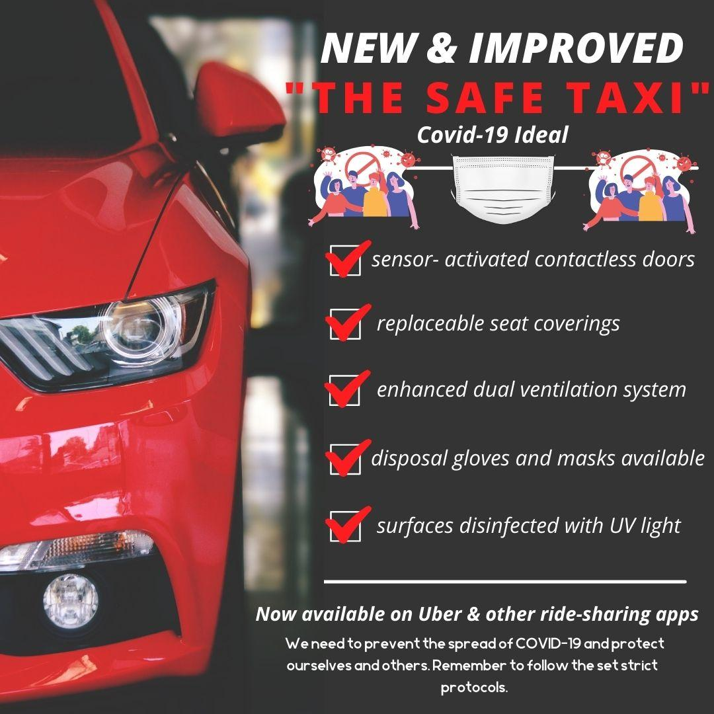
Marketing
Target millennials and older generations
Instagram and Newspaper
To the right is an example of an ad we intend to use.

Slide 19

